Slide 1

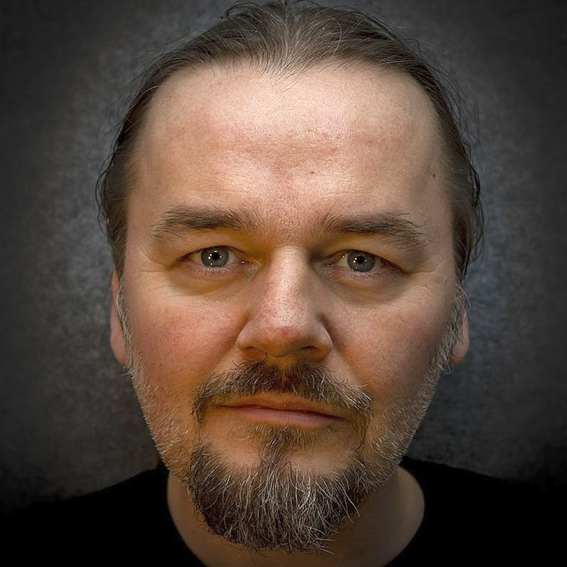


Introduction
BENGT GRØNÅS Senior Solutions Engineer 8+ years in VMware Based in Oslo, Norway Covers Nordics and Baltics Often a Lab Captain at Vmware Explore / VMworld Music production, long travels; hiking, motorcycle, chess @bgronas
Kate Rychlik Senior MultiCloud Management Specialist Solution Architect Aka. Kasia, Katia, etc 2+ years in VMware Based in Amsterdam, Netherland Covers Benelux Race cars, DIY, skiing, cooking & baking @krychlik
Notes:
Here we are
NEXT: Let’s have a slow start and a look at WHY we should have VROPS/AO

Slide 2








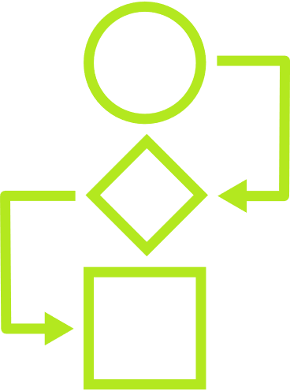






APP STRATEGY
Retain
Rehost
Replatform
Refactor
Retire
CLOUD OPERATING MODEL
3. MANAGE ACROSS CLOUDS
VMware Multi-Cloud Management
Cost
Performance
Secure Config
Delivery
2. BUILD PLATFORM
Kubernetes Runtime and Management
1. BUILD CLOUDS
VMware Cloud
Public Cloud
Cost
Performance
Secure Config
Delivery
Cost
Performance
Secure Config
Delivery
IAAS CAAS PAAS
IAAS CAAS PAAS
VMware Multi-Cloud Management
PRIVATE
PARTNER
SOVEREIGN
TELCO
EDGE
VMware Infra

Slide 3
VMware Cloud Operating Model Tenets
Powered by VMware Cloud Management
VMware Cloud Operating Model
Process
Delivery
Performance
Build VMware Clouds
Embrace Multi-Cloud
Cost
Transform ITOps
Cloud experience out-of-the-box
Align CloudOps
Unified management across multiple clouds
Security
Notes:
A cloud operating model consists of 3 competencies:
Service Delivery
Operations
Governance
A cloud operating model should be able to up-level your existing virtual environments to a fully functioning self-service cloud, and
bring consistency in delivery, operations, and governance to multi-clouds.
It should incorporate a set of processes and capabilities that efficiently extend these capabilities to additional clouds or environments
through a repeatable, extensible on-boarding process.

Slide 4
Challenges with Operations Management
Includes optimizing processes and ensuring staff availability & skills
Meet SLAs
Modernize
Visibility
Manage Costs
Manage Risk
Deliver performance to meet business needs
Better use existing resources
Troubleshoot to make quick decisions
Licensing, CAPEX, OPEX
Stay compliant and secure
Notes:
Customers tell us that they have several challenges with operations management, and I’ll walk you through a few of them.
With operations management it can be complex and sometimes silo’d, and customers say they need to:
Meet SLAs - Struggling to deliver performance at minimal costs, to meet business needs
Modernize - Spinning up a new datacenter, or have consolidation & modernization projects - and need to better use existing resources
Unified Visibility - Deploying SDDC technologies or integrating public clouds, and struggling to get unified visibility for troubleshooting to make quick decisions
Cut Costs - Looking at ways to cut costs because they continue to rise as more applications are built on containers. While this better enables developer agility, the visibility and management can be difficult. Here’s a fun fact = 86% of those surveyed said they expect containers, microservices, and Kubernetes to have significant impact on their multi-cloud management strategy in the coming years.
Manage Risk - Want to manage risk and stay compliant while assuring performance
TRANSITION: VMware can help ease your organization’s journey to cloud – wherever you are in your journey (private, moving to hybrid or multi-cloud) with VMware Aria Operations™.

Slide 5



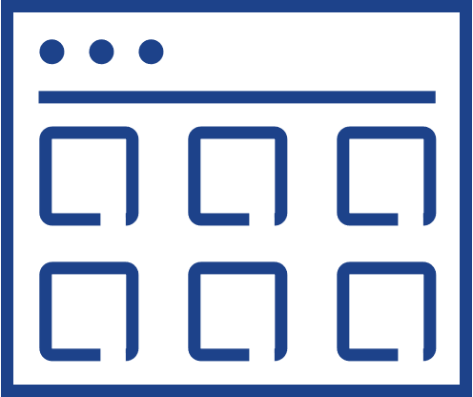
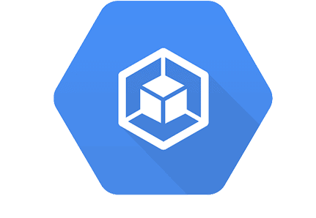
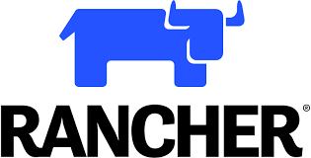
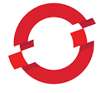
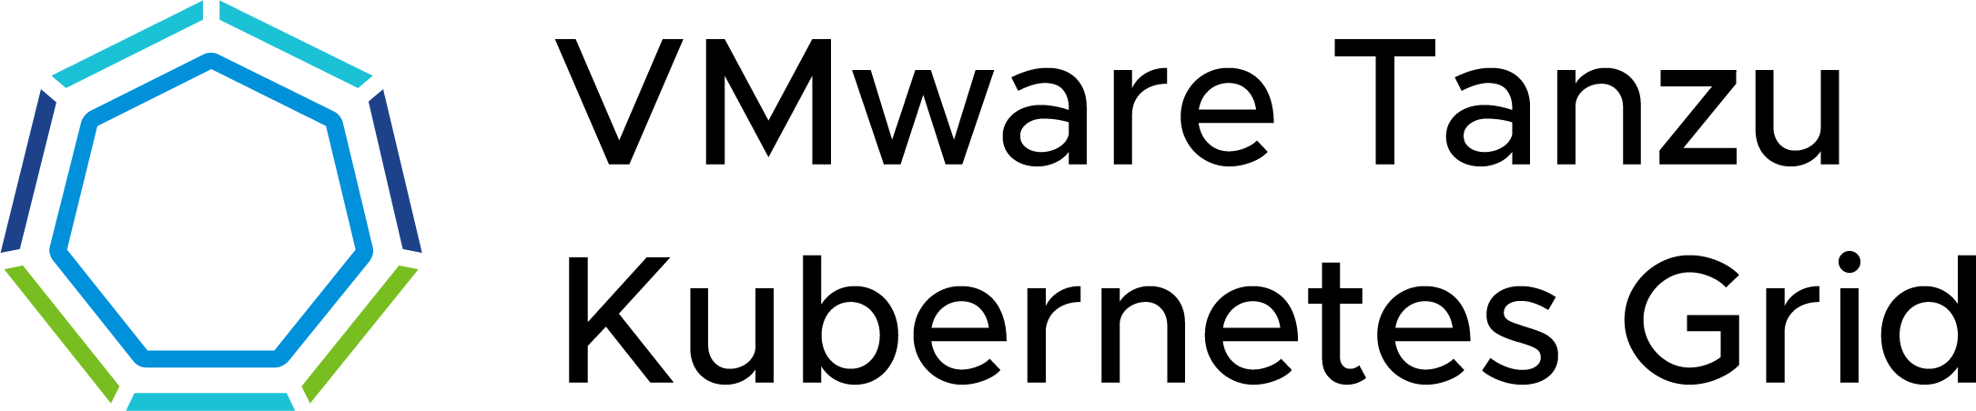
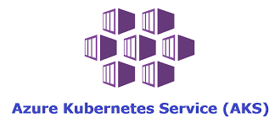
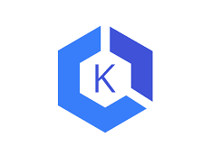



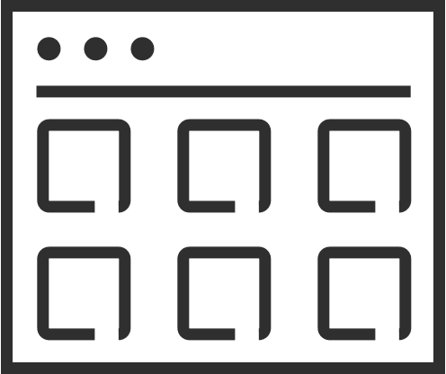
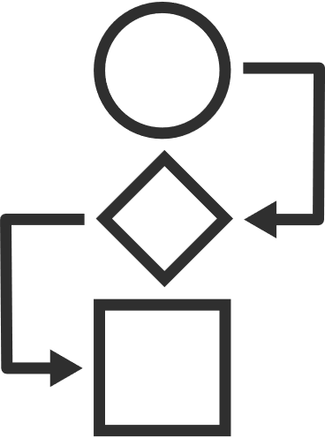
What does good look like?
The Cloud Operating Model
App strategy
Retain
Rehost
Replatform
Refactor
Retire
CLOUD OPERATING MODEL
2. MANAGE ACROSS CLOUDS
VMware multi-cloud management
Cost
Performance
Secure Config
Delivery
Kubernetes runtime and management
1. BUILD CLOUDS
VMware Cloud
Public Cloud
Cost
Performance
Secure Config
Delivery
Cost
Performance
Secure Config
Delivery
IAAS CAAS PAAS
IAAS CAAS PAAS
VMware multi-cloud management
PRIVATE CLOUDS
PARTNER CLOUDS
SOVEREIGN CLOUDS
TELCO CLOUDS
EDGE CLOUDS
EDGE
VMware infrastructure
Notes:
This is how you achieve success in the multi-cloud transformation
App Strategy
All customers have an app strategy for both new and existing applications.
As they look to rationalize and modernize their application portfolios, they need to decide whether to retain, rehost, replatform, refactor or even retire them, possibly replacing them with SaaS versions.
It's always a combination – you have traditional Apps, Kubernetes-based apps, cloud native apps, SAS-based apps – across the board.
Development team needs to make decisions on where to deploy new apps and whether to migrate existing ones these apps on different clouds, whether native public clouds or VMware-based clouds.
To do this right, they need an effective, efficient method of managing their multi-cloud world, one that supports their application and business objectives.
This involves not just using the right cloud management technology but implementing it in the broader context of the right people and process as well.
VMware’s Cloud Operating Model can help with this.
So what is a cloud operating model?
Public Cloud
In the case of the native public clouds, developers can directly consume the services they require.
The native public clouds provide an interface where developers can go and consume the various IaaS and PaaS services in a self-service way.
They’ve got infrastructure as code with things like AWS Cloud Formation templates.
They’ve got Cloud Watch and Cloud Trail in AWS that provide performance, logs and metrics, as well as cost APIs and security APIs.
VMware Cloud
In the case of VMware Cloud environments what we have to do is convert them into the experience of a native public cloud
That's where VMware Aria Management comes in.
Infrastructure and Cloud Operations team first have to set up the cloud constructs.
Second, they have to set up the set of services that they want to deliver.
They deploy their database as a service, their IaaS services, they curate their image sizes and flavors and define their availability zones.
Once they have curated the services, they then manage the cost of applying capacity, performance and security to this cloud.
So, the combination of VMC on AWS, VMware Cloud Foundation or Project Dimension and the VMware Aria cloud management capabilities makes a VMware Cloud.
It delivers the same set of self-service IaaS, performance, cost and security APIs to the developer, so now the developers can directly consume from VMware Cloud.
Multi-cloud and Kubernetes Management
We can also extend these capabilities to native public clouds by creating a common IaaS service across not just VMware Cloud but all public clouds.
And with Tanzu Mission Control we provide a common Kubernetes management platform across all VMware and native public clouds.
The question is, do we need anything else?
More organizations are delivering applications across public clouds and at the edge, and they’re increasingly using Kubernetes to manage and scale their modernized and cloud-native apps.
However, managing apps and infrastructure in a multi-cloud, especially public cloud, and multi-technology environment is complex.
Teams have to control costs, ensure performance, and manage consistent security policies across these diverse and distributed environments.
Since the developers are developing across multiple clouds, a new set of issues becomes relevant.
For example, how do I know what it costs to deploy my service in one cloud versus another?
How do I secure my clouds, and how do I define policies for security once and apply them across all clouds?
How do I look at the performance of an application that may be deployed across two or three clouds?
This is where the new capabilities of our VMware Aria offering comes in.
VMware Aria, which provides a set of end-to-end solutions for managing the cost, performance, configuration, and delivery of infrastructure and cloud native applications.
Powering VMware Aria is VMware Aria Graph, a graph-based data store technology that captures the complexity of our customers’ multi-cloud environments.
VMware Aria is uniquely positioned to address managing the cost, performance, configuration, and delivery of infrastructure and cloud native applications.
VMware Aria doesn't disintermediate the consumption of the cloud, but what it allows you to do is apply policies against that consumption.
It enables you to get visibility into cloud costs and, allows you to optimize those costs, and then later enables you to take automated decisions based on your cost characteristics.
It does the same thing with secure configuration, same thing with performance, and the same thing with delivery.
It thereby gives you a set of capabilities around financial and performance management security and delivery automation that developers can use.
So, it's taking all the set of data, synthesizing it and making it available for the developers.
This allows them to run their environment on a continuous basis and deliver the app performance, cost and security that they need.
Cloud Operating Model
This entire set of capabilities as leveraged by Infrastructure and Operations teams and the Cloud Center of Excellence is what we call the cloud operating model.
The Cloud Operating Model is a holistic story that brings people, process and technology together.
An effective Cloud Operating Model can deliver spectacular results.
Customer examples include a 25% decrease in cloud spend and a 30% increase in productivity.
The biggest root cause of problems are misconfigurations; customers who do config management right can see a 93% decrease in unplanned downtime.
Customers also enjoy a 50% reduction in software costs.
We believe we are the only vendor with capabilities that truly capture the complexity of our customer’s multi-cloud realities empowering them to handle the increasingly challenging requirements of the multi-cloud world.

Slide 6
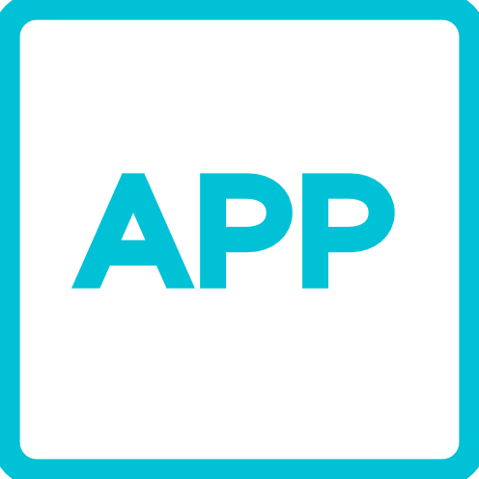
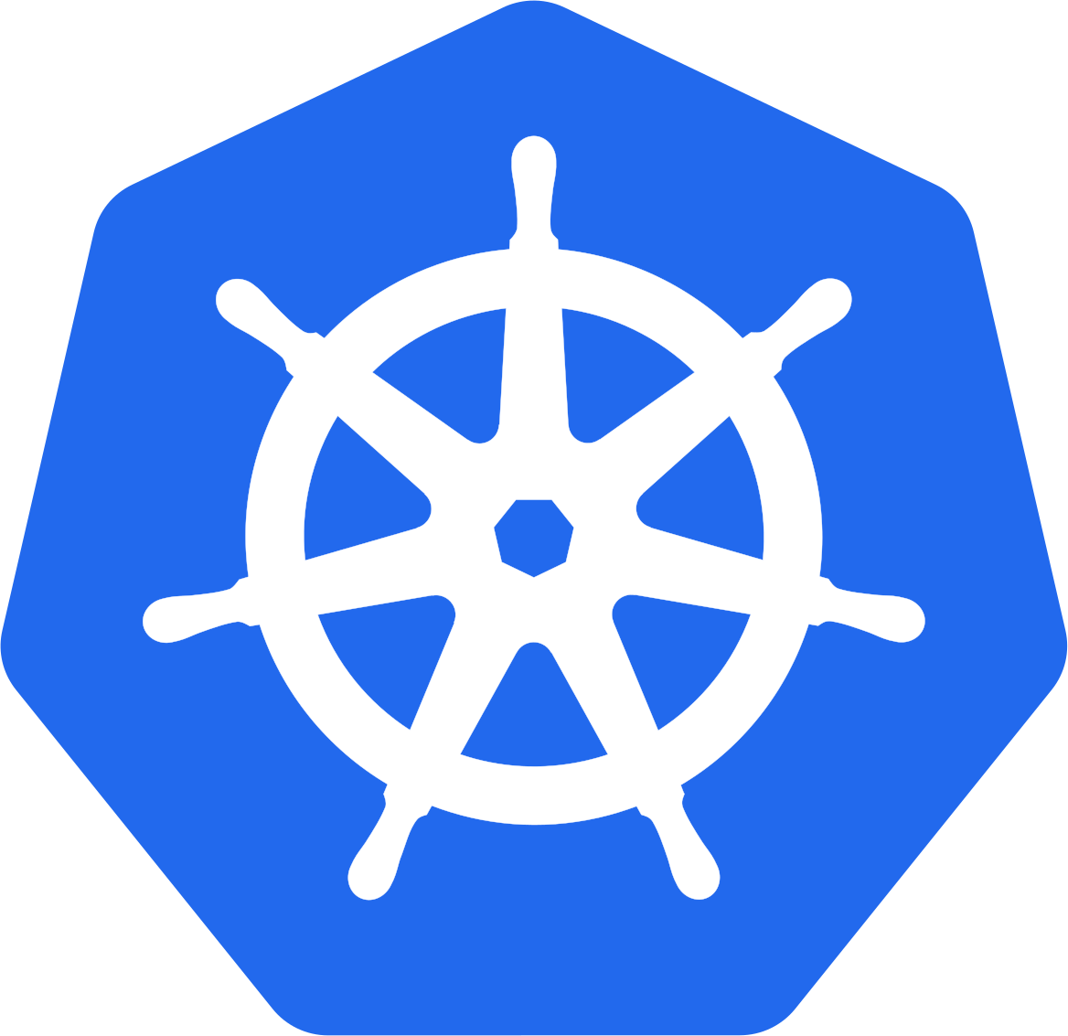
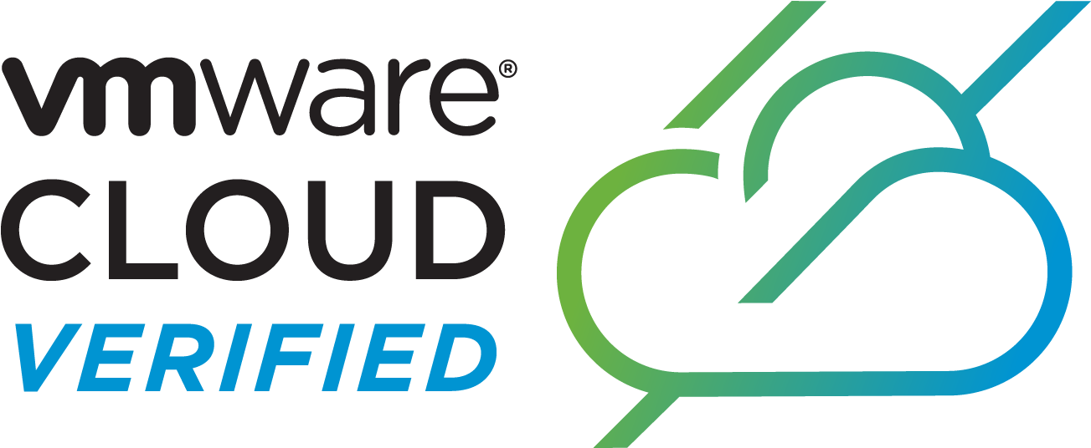
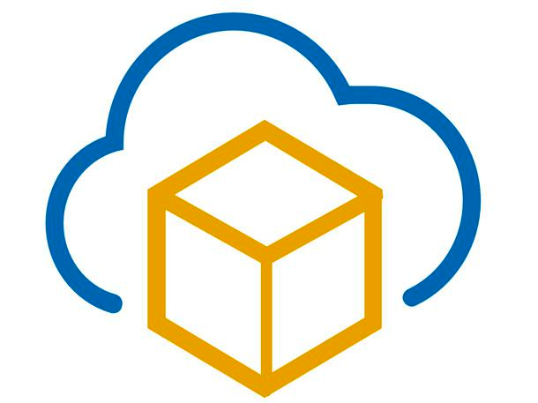
VMware Aria Operations Core Capabilities
Powered by AI, from apps to infra, across VMware Cloud on AWS
Continuous Performance Optimization
Apps
Continuous Performance Optimization
Assure performance with automatic workload placement and balancing based on business and operational intent.
VMware Cloud Foundation
Containers
Efficient Capacity & Cost Management
Run infrastructure for optimal consolidation, proactive planning, and procurement.
Public Cloud
App-Aware Intelligent Remediation
Predict, prevent, and troubleshoot across VMware Cloud and multi-clouds, from applications to infrastructure.
Edge
Unified Ops Platform
Powered by ML
Integrated Configuration & Compliance
Reduce risk and enforce IT and regulatory standards with integrated compliance and automated remediation.
Partners
VMware Cloud
Notes:
What is Aria Operations used for with our customers?
Capacity Planning and Adjustments
Critical Troubleshooting
App & OS Monitoring
Cost Planning and Management
TCO & ROI
Workload Optimization
Reporting Automation
Leveraging vSphere Tagging
Operationalizing VCF
To Maintain efficient operations
Enable governance and consistency
Continuous Performance Optimization - Continuously optimize app performance with automatic workload placement and balancing based on business and operational intent
Efficient Capacity Management – Run infrastructure like a public cloud — optimal consolidation, proactive planning, and procurement
Intelligent Remediation - Predict, prevent, and troubleshoot across hybrid and multi-cloud, from apps to infrastructure
Integrated Configuration and Compliance - Reduce risk and enforce IT and regulatory standards with integrated compliance and automated remediation

Slide 7
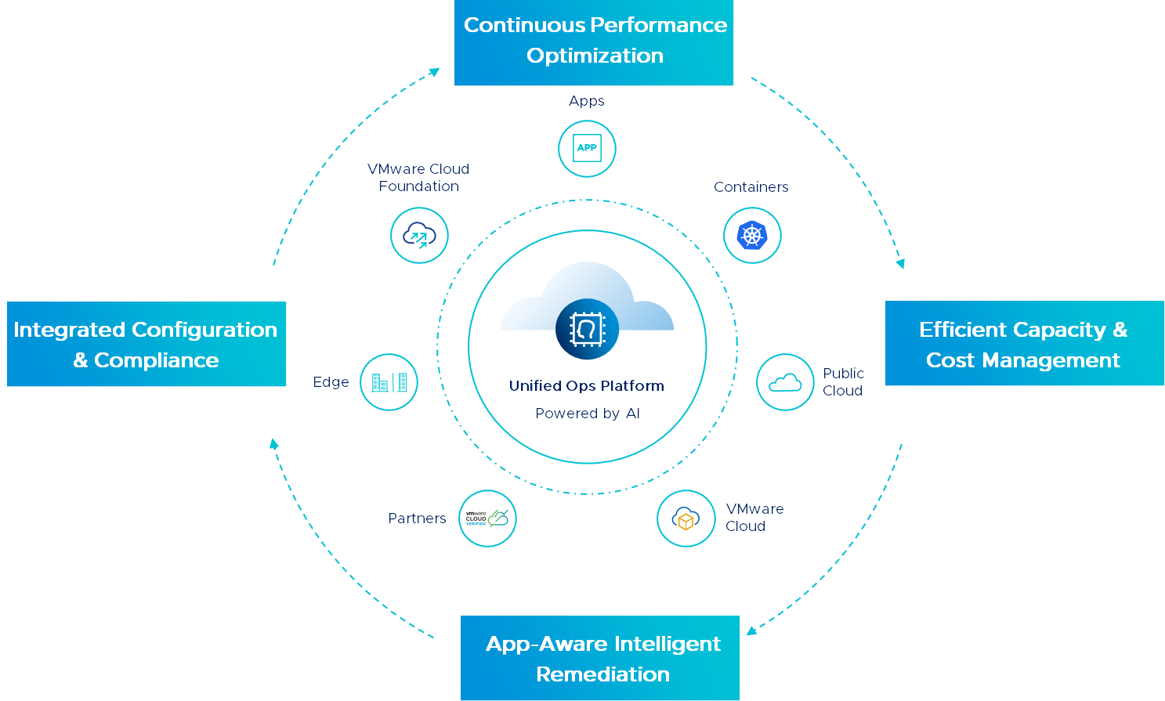
Self-Driving Operations with Aria Operations
Powered by AI, from apps to infra, across VMware Cloud and multiple public clouds, on-premises or SaaS
Continuous Performance Optimization
Notes:
How do I maintain efficient operations
How do I enable governance and consistency
How do I minimize complexity?
..and enable governance and consistency
Continuous Performance Optimization - Continuously optimize app performance with automatic workload placement and balancing based on business and operational intent
Efficient Capacity Management – Run infrastructure like a public cloud — optimal consolidation, proactive planning, and procurement
Intelligent Remediation - Predict, prevent, and troubleshoot across hybrid and multi-cloud, from apps to infrastructure
Integrated Configuration and Compliance - Reduce risk and enforce IT and regulatory standards with integrated compliance and automated remediation
Flexible Deployment – Available as on-premises software or as a VMware cloud service
Continuous Performance Optimization - Continuously optimize app performance with automatic workload placement and balancing based on business and operational intent
Efficient Capacity Management – Run infrastructure like a public cloud — optimal consolidation, proactive planning, and procurement
Intelligent Remediation - Predict, prevent, and troubleshoot across hybrid and multi-cloud, from apps to infrastructure
Integrated Configuration and Compliance - Reduce risk and enforce IT and regulatory standards with integrated compliance and automated remediation
Flexible Deployment – Available as on-premises software or as a VMware cloud service

Slide 8
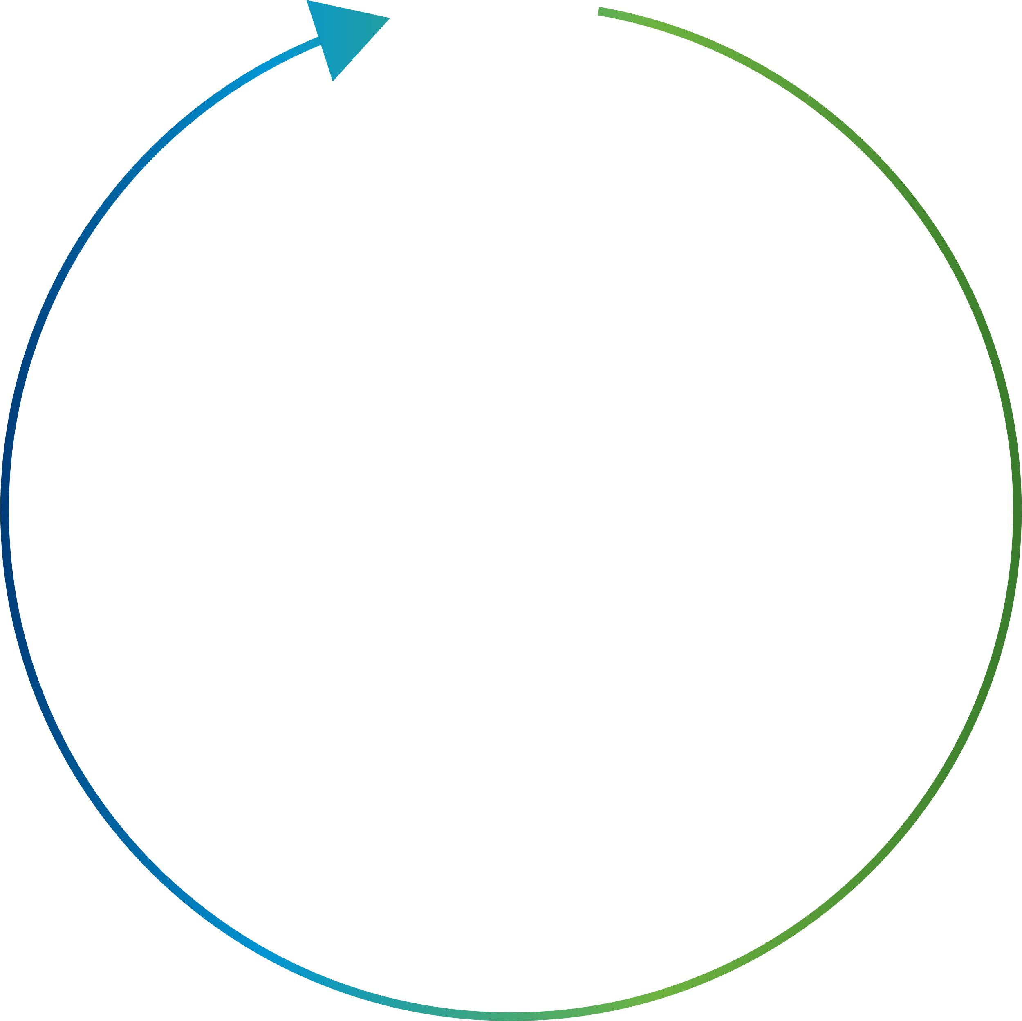
Aria Operations Delivers Consistent Operational Model Across Clouds
Capacity Management
Performance & Availability
Network Management
Costing and Planning
Compute
Network
Storage
Storage Management
Topology Analysis
Workload Balancing
Log Data Analysis
Notes:
VMware approach is different and addresses the needs of operations management.
This is where intelligent operations delivered by vRealize Operations, integrated with vRealize Log Insight and vRealize Business for Cloud can help our customers. Intelligent operations solution is designed to help customers plan, manage and scale their software defined datacenters (SDDC) and multi-cloud environments. Intelligent operations brings together all management functions – performance management, capacity, log analytics, cost analytics, planning, topology analysis, troubleshooting and automated workload balancing – in one integrated, highly intuitive, scalable and extensible platform.
VMware vRealize® Operations Manager™ delivers intelligent operations management across the physical, virtual, and cloud infrastructure, enabling the vCloud Air Network service provider to efficiently operate a cloud platform and meet required customer service level agreements (SLAs).
vRealize Operations Manager correlates Application and Infrastructure data in a unified easy-to-use management tool that provides control over performance, capacity, and configuration, with predictive analytics driving proactive policy-based automation and workload placement.
Performance Monitoring and Analytics
Predictive Distributed Resource Scheduling for compute and storage
Capacity Management (e.g. Modeling, What-ifs, trending, metering, right-sizing, optimization
Guided Remediation with Automated Actions
Visualization: Out of the box customizable dashboards, views, reports, heat maps and charts
Native vSAN monitoring and management
Hardening for all SDDC components
Automated and Schedulable workload placement and balancing
Monitoring of OS resources (CPU, disk, memory, network)
Multi-cloud Monitoring Management Packs: AWS, vCloud Air, OpenStack
3rd-Party Management Packs: Storage, Networking, vCloud Director, etc…
Service Discovery & Application Dependency Mapping

Slide 9
Use Cases Unlocked by Aria Operations
Hyperconverged Infrastructure Operations
Consistent VMware Cloud Operations
App-aware Operations
Integrated Compliance
Unified Public Cloud Monitoring
Notes:
Hyperconverged Infrastructure Operations – Self-driving operations management, optimization, and planning for hyperconverged infrastructure including vSAN performance optimization, capacity/cost management, and troubleshooting, and HCI capacity/cost planning.
Consistent VMware Cloud Operations – Holistic self-driving operations management, optimization, and planning for VMware-based clouds including VMware Cloud Foundation, VMware Cloud on AWS, and vSphere-based VCPP clouds.
App-aware Operations – Infrastructure optimization with application-level visibility and awareness facilitating better decision-making and communication between infrastructure providers and consumers.
Container Operations – The self-driving operations framework applied to container-based workloads
Unified Public Cloud Monitoring – Visibility, monitoring, and planning for workloads residing on multiple public clouds including AWS, Azure, GCP, and others.

Slide 10
Initial Recommendations / Quick win
Recommendations. Focus efforts on critical & recent.
Declutter the environment with Reclamation
VM RightSizing –Group Bronze Class VM’s. Schedule rightsizing
Common used dashboards – Good OOTB or custom dashboards
Capacity Planning – Time Remaining. Set up policies on 1 particular cluster for capacity planning.
Troubleshooting Proactive – Workbench
Dashboard Folder – List your favs
Custom Groups for application types etc.
Adjust cost drivers to improve accuracy. Import env cost reports - Reports
Showback and Sustainability (Waste Management) Reports to Senior Management + ESG Team
Config/Compliance Management Reports: NTP, DNS, Power Management
Integrate Storage Arrays from 3rd Parties – Management Packs
Capture legacy O/S's using configuration dashboards and reports
Outbound alert settings
Change the default email payload to something more user friendly. See - Custom Aria Ops Content
Change the Home landing page to a more useable dashboard e.g vSphere Inventory
Skyline Data MP – Feed Security Vulnerabilities to Aria Ops. Send as report to SecOps
Enable a compliance pack. vSphere Security Guide vs the 100's line excel document = good start!

Slide 11
Optimize & Plan Capacity across Private, Hybrid and Public Clouds
“
“
“
What is my total capacity and how much is used/remaining
When will I run out and how much more is needed? Cost?
How much capacity can I reclaim? Cost?
“
“
“
“
“
What is the cost of running VMs on private vs hybrid or public cloud?
What are the costs and usage in private/ public clouds?
“
“
Notes:
And there are more questions. You actually know all these questions. In fact, you’ve probably been asked before, and have been wondering about the answers.
How bad is the over-provisioning?
Which VMs can be right-sized, without impacting performance?
Does any VM abuse the shared IaaS platform?
Anyone can be running IOmeter without you knowing it. Later we’ll show you one real life example.
How healthy is your vSphere environment?
What vSphere alarms are we getting?
When do they happen? How often do they happen? Are you getting alarms at unexpected places?
Your IaaS platform is healthly and performing.
Sure. What does the logs say? Any early warning buried deep in the million lines of logs?
Most VMware admin/architect do not read the logs. Do you understand what the logs say?
Knowing what your logs say give you comfort level that your SDDC is operating well. Definitely a good thing to do before going for that 2 week vacation ;-)
Who makes what changes to what objects in vSphere and when?
This is a common auditor question. It includes additional questions such as who issue what CLI command to which ESXi
In the next session, we will begin answering all these questions, and more. By the end of the day, you should have the solution and dashboards to answer them all.

Slide 12


Capacity Planning
Models of capacity planning
Demand
Allocation
Capacity Monitoring
Helps monitor the day to day capacity usage on the basis of actual resource demand of workloads.
Drives Utilization
Provides maximum utilization as one can continue to overcommit to drive utilization.
Performance Based
Performance is the key consideration and capacity is full as soon as performance is as risk.
Procurement Planning
Helps in procuring new resources with an estimated overcommitment ratio.
No Overcommitment
Helps avoid overcommitment for running business critical workloads.
Showback and Reporting
Used by IT providers in shared services to not overcommit beyond contractual obligation.

Slide 13
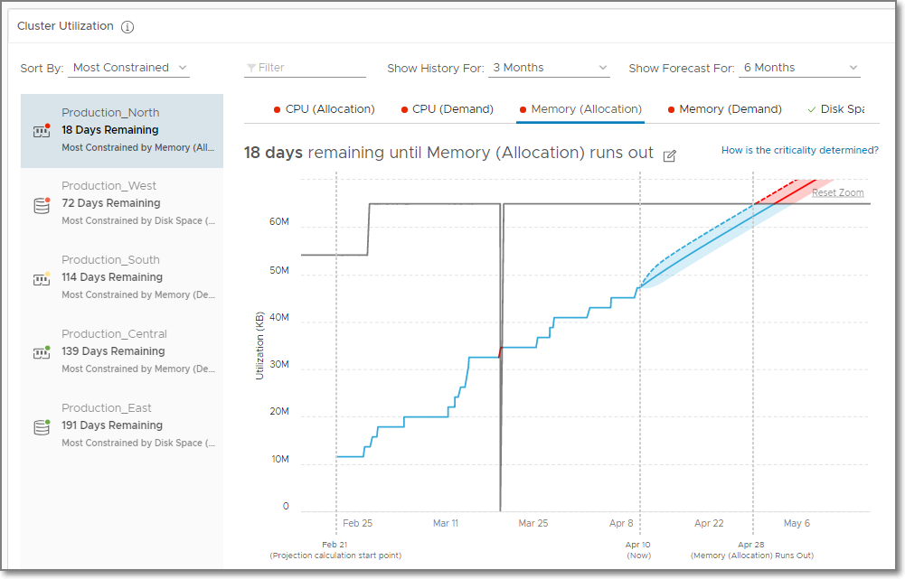
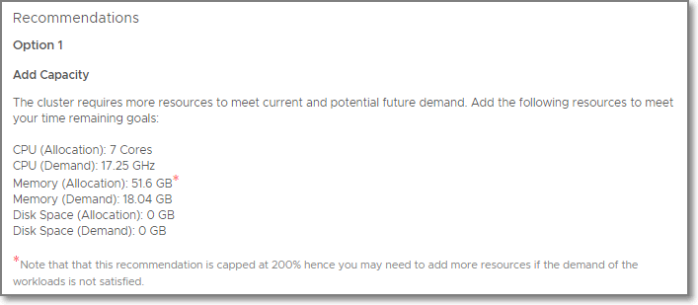
Assess Capacity, Predict Demand, and get Recommendations
Assess Capacity based on Demand and Allocation (Optional)
Assess Overall Capacity: Single view of the world
Capacity Projection: View current utilization and projection per resource (CPU, Memory, and Disk Space)
Get recommendations
Reclaim unused capacity
Add capacity in private cloud
Run what-if scenario to migrate to public cloud
Projected Utilization
Notes:
Aria operations capacity analysisys in based on “Forward-Looking” Analytics Engine, that is capable to provide Real-Time Predictive Capacity Analytics.
It’s based on industry-standard statistical analysis model of demand behavior

Slide 14




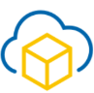
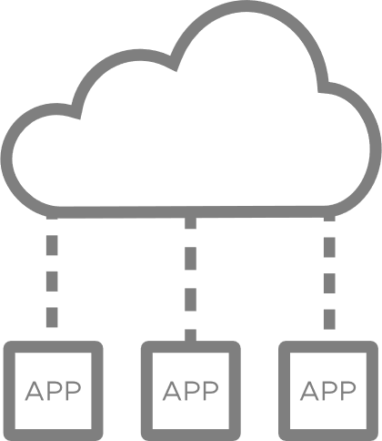
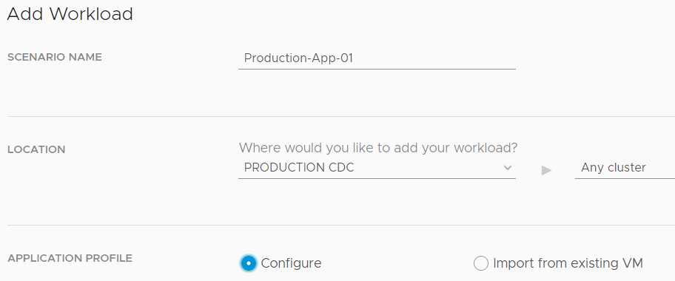
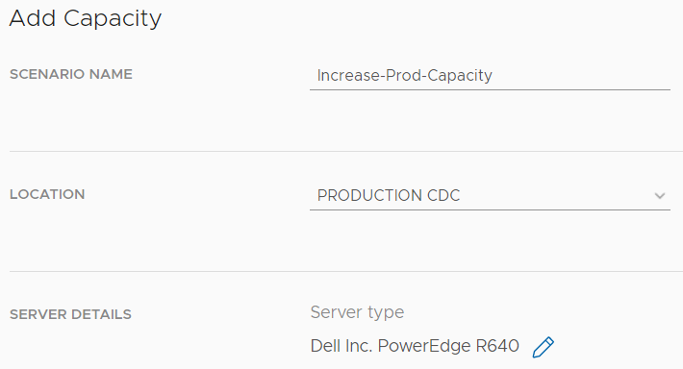
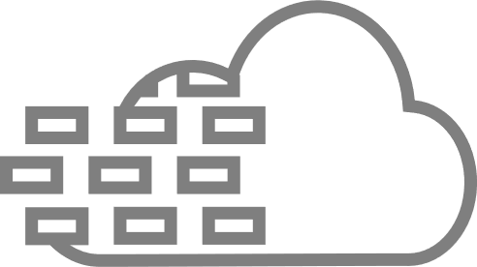
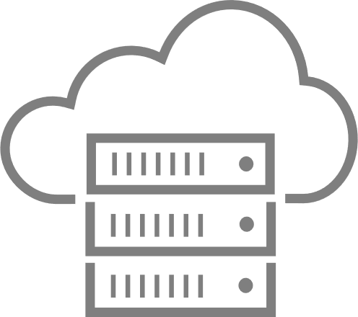

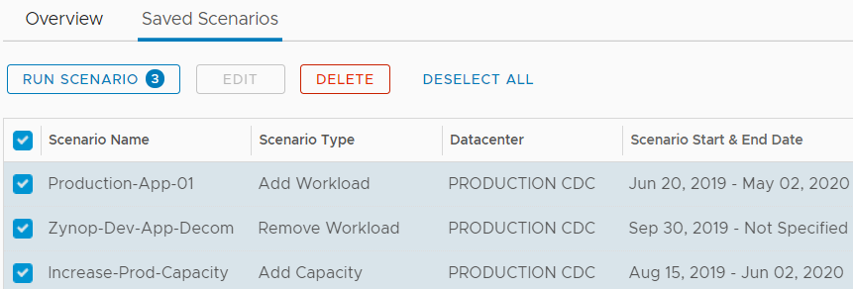
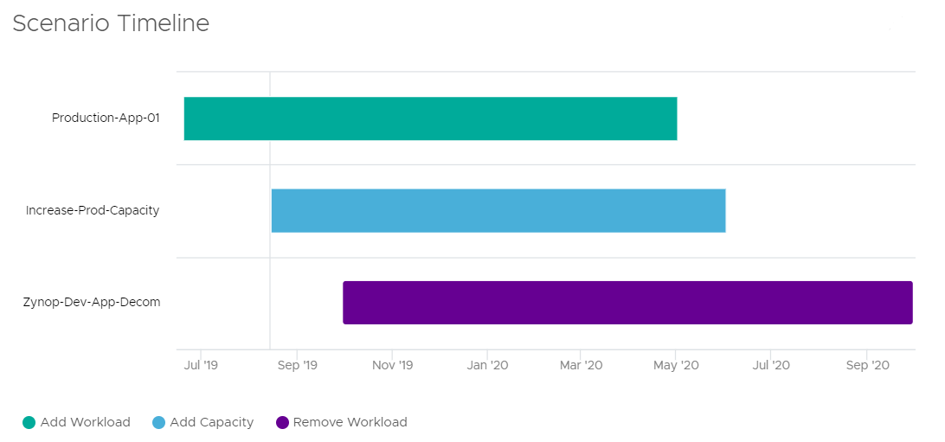

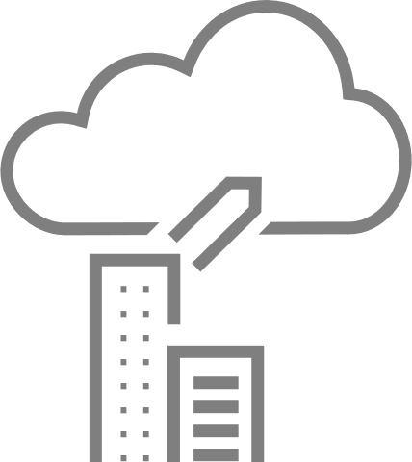
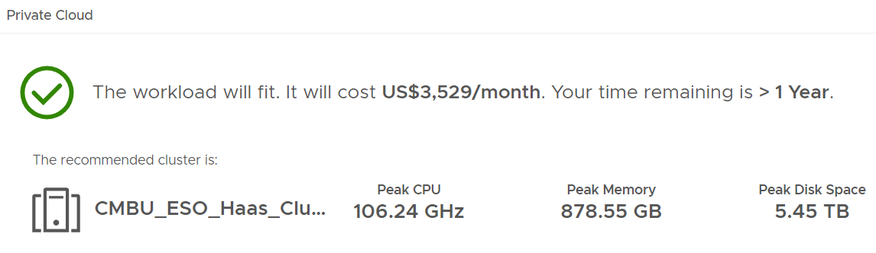
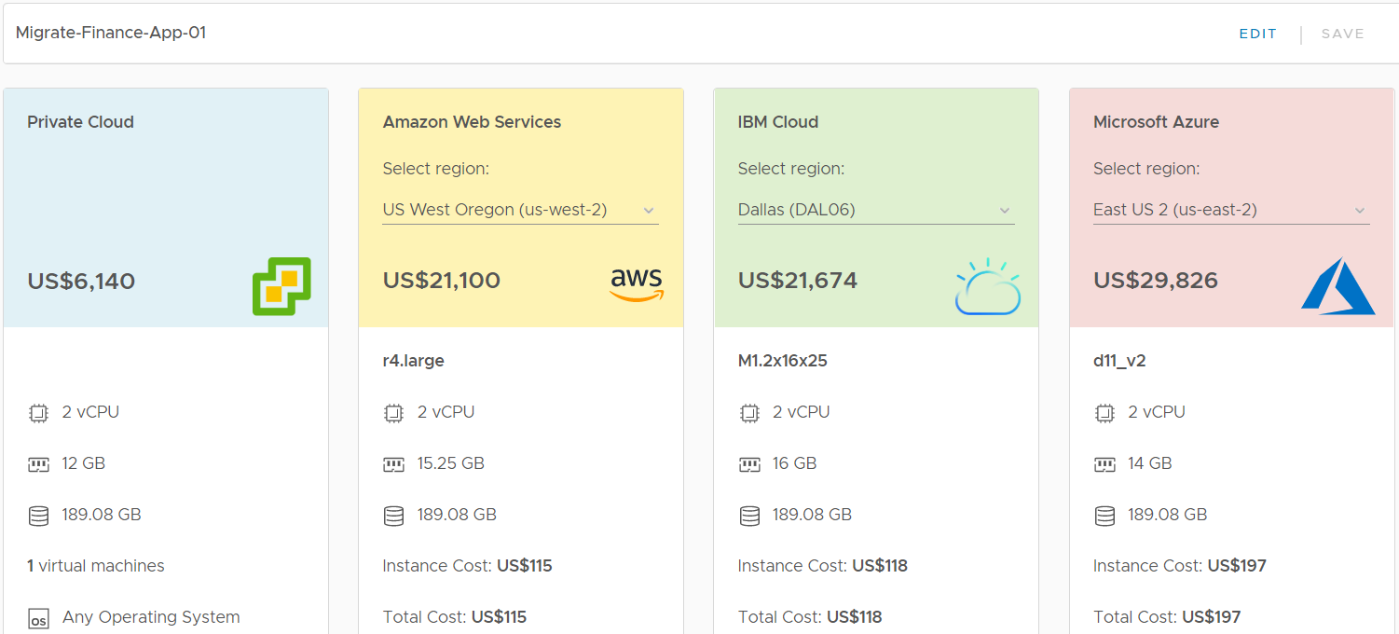
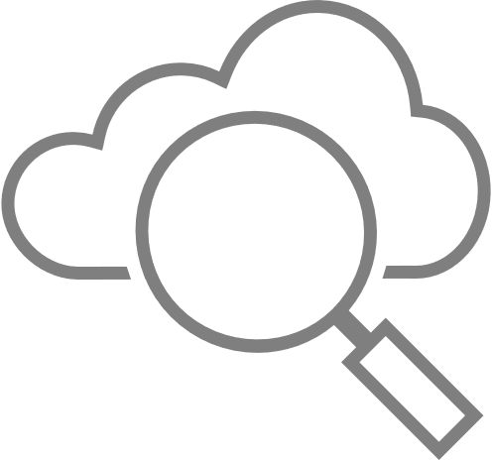

Plan for future needs and datacenter migration scenarios
Plan and stack multiple scenarios to arrive at accurate capacity decisions
Capacity Planning Scenarios
CHOOSE SCENARIOS
Onboarding new workloads
Workload Planning
Physical Infra Planning
HCI Planning
Cloud Planning
Decommission existing workloads
DEFINE SCENARIOS
Server procurement planning (includes HCI)
Decommission existing servers
Server hardware refresh
STACK SCENARIOS
Hybrid cloud migration
Public cloud cost comparison
VISUALIZE OUTCOMES

Slide 15
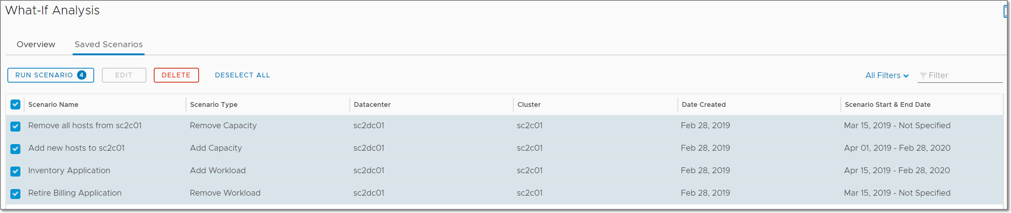
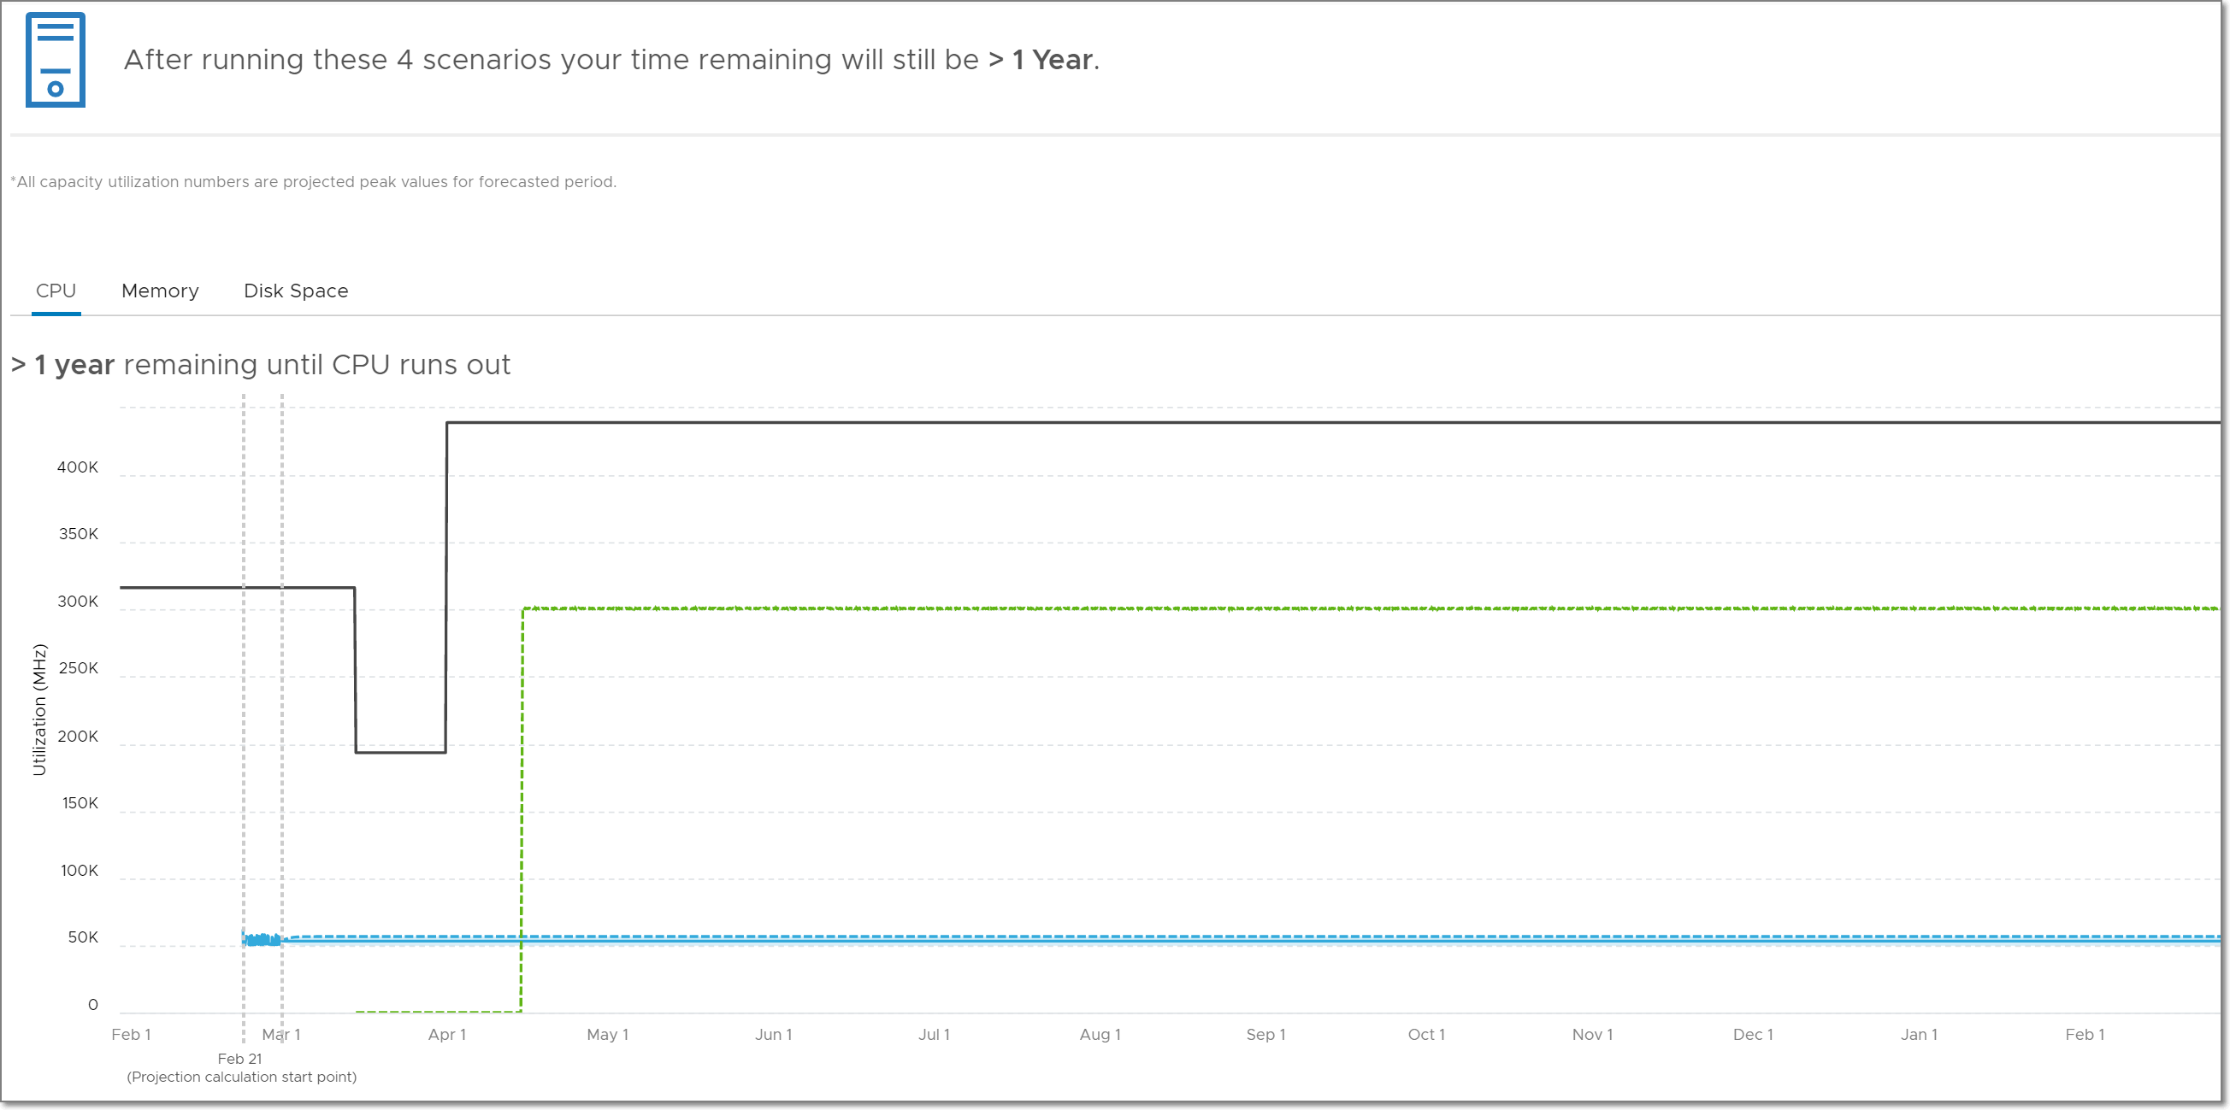
What-If: Stacked Scenarios
Plan complex situations the easy way
Stack multiple What-If Scenarios together by selecting more than one at a time
Enables capacity planning for real-life business scenarios
Application Deployment
Application Retirement
Hardware Refresh
Decommission Hosts
Supported Stacked Scenarios
Add/Remove Workload + Add/Remove Hardware
Add/Remove Workload + Add HCI Node

Slide 16
Continuous Performance Optimization
“
“
Can I achieve automated resolution of VM performance issues?
“
How can I make sure clusters don’t get filled beyond target?
“
How do I prevent VMs from getting deployed to clusters that are full?
“
“
“
Can I learn to predict & avoid contention?
“
“
“
Can I limit VM movement to manage licensing costs?
Can I consolidate and reuse for a new project?
“
“
Notes:
My environment is growing like crazy! Can I achieve automated resolution of VM performance issues without having to deal with them vm by vm? This is the marketingApp VM – it spikes every Mon-Wed – just learn its behavior and keep it happy
DevOps are deploying VMs at much faster rate, Clusters get filled up fast, How do I ensure that VMs don’t get deployed to clusters that are full or facing perf issues?
How do I ensure that clusters don’t get filled up beyond a target utilization level that will ensure there are enough resources for all?
If clusters and datastores do get full, How can my team build confidence to move VMs around that will guarantee that the VMs and the applications get the resources they want?
Budget cuts are happening, I must ensure Windows and Oracle license costs are contained. Can I limit their movement to a few set of clusters that I pay for?
I have an upcoming new project and need to free up production clusters, can I stack up to fit the VMs to minimal possible hardware to free up space to put new project VMs?

Slide 17
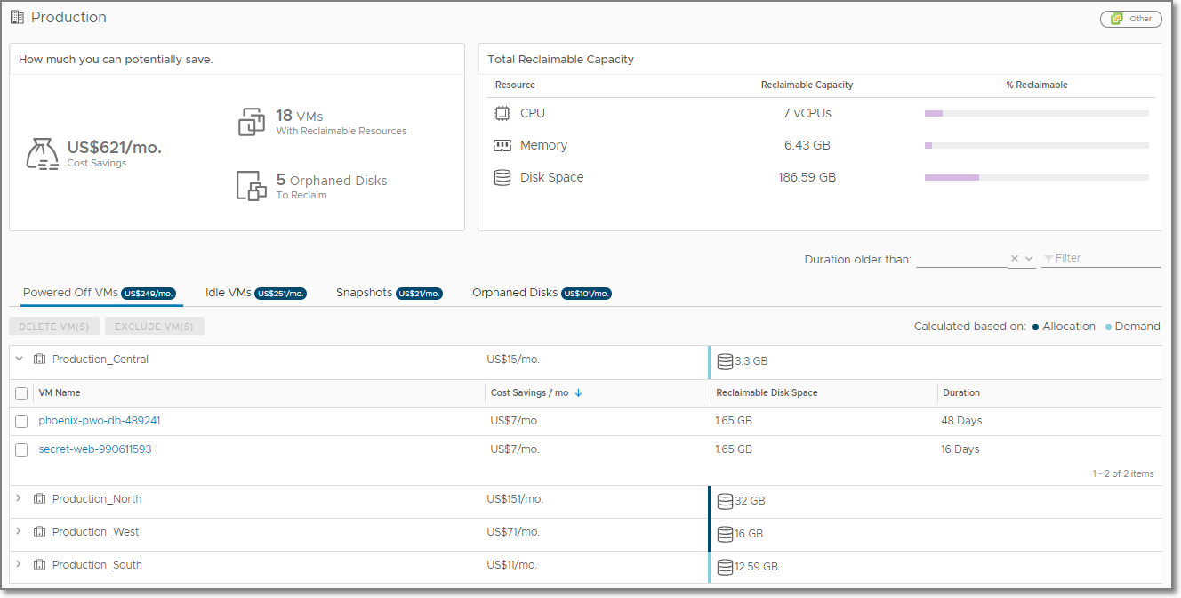
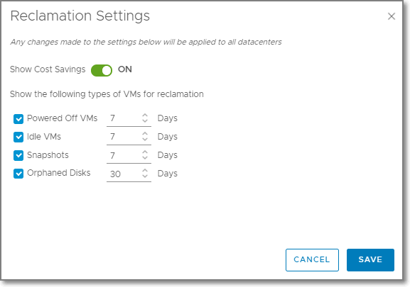
Reclaim Capacity and Automate Cost Savings
Define Business Intent for Reclamation:
Turn on or off cost savings on this dashboard.
Specify your desired time requirements for reclamation
Powered Off VMs
VMs that have been continuously powered off during the defined period of time
Idle VMs
VMs that have used no more than 100MHz CPU during the defined period of time
Snapshots
VM snapshots that have existed for the entire defined period of time
Orphaned Disks
VMDKs on datastores that aren’t connected to any registered VMs and have not been modified during the defined period of time
Reclaim and Save
How long before VMs get flagged as Reclaimable
Notes:
One key area of investment for vRealize Operations is adding new constraint driven predictive capacity analytics. This will also result in a reduced footprint of the product enabling us to scale to much higher sizes of deployment. These new analytics will feature a more accurate cloud aware projection algorithm. It will also help us surface up and visualize utilization with cost awareness as one along with cost aware optimization opportunities. This is key in today’s world of cloud where consumption and cost are two sides of the same coin. We will also feature a unified experience for understand overall utilization, opportunities to optimize further and plan ahead for on prem, public and VMc clouds.

Slide 18
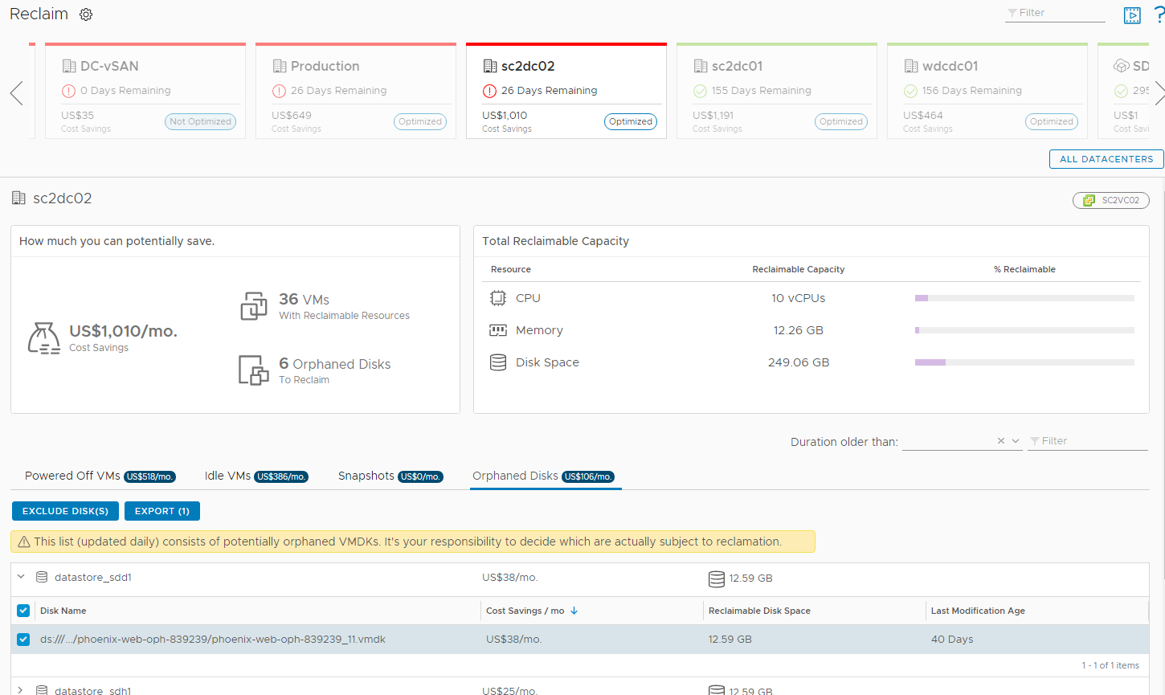
Reclaim: Orphaned Disks
Orphaned Disks are VMDKs that exists on a datastore that are not attached to any registered VMs
Orphaned Disks visible on Reclaim page
Show Reclaimable Disk Space and Cost Savings per month
Export Orphaned Disks to CSV
Last Modification Age is file modification timestamp
Reclaimable Orphaned Disks
Export to CSV
Orphaned Disks
File Modification Date
CSV Export

Slide 19
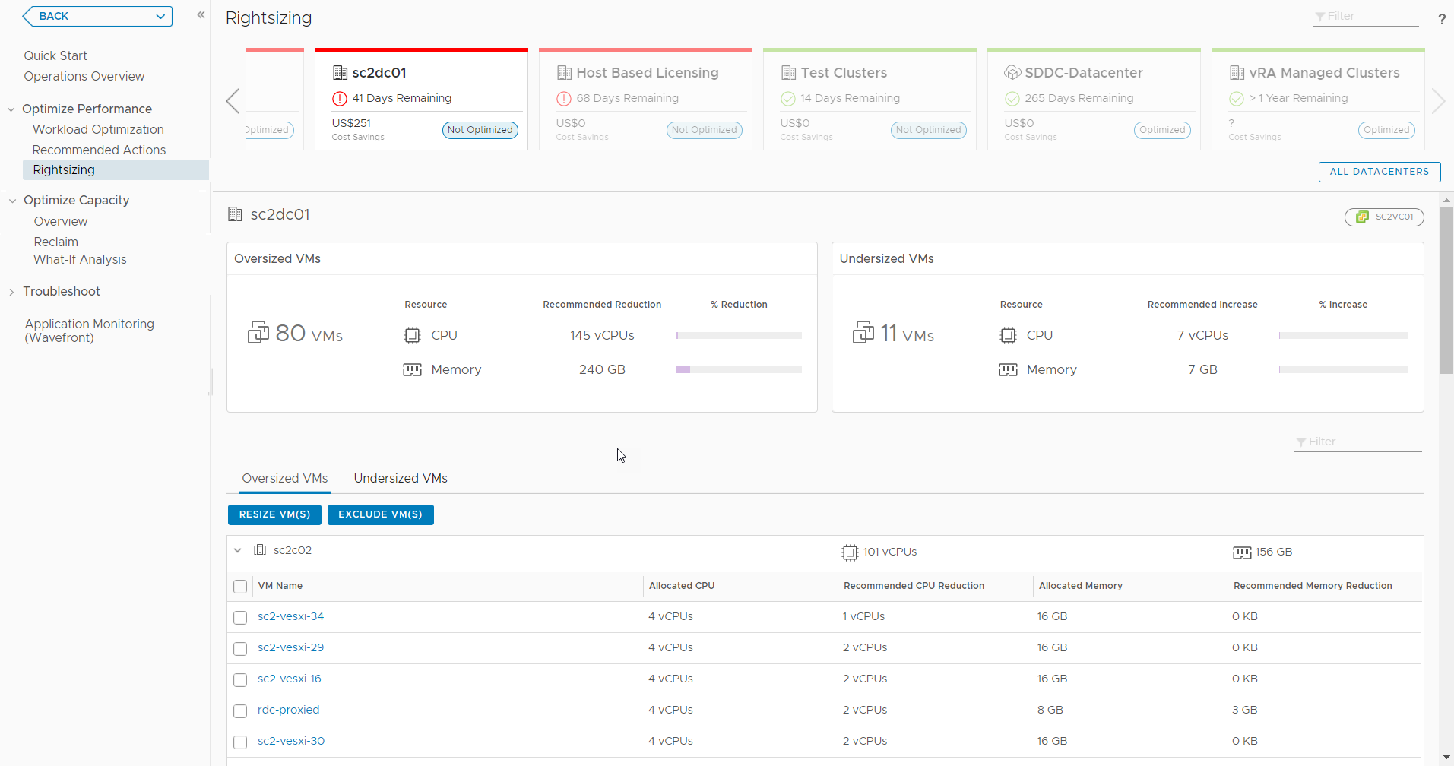
Workload Optimization – Simplified Rightsizing
Because moving VMs can’t solve all your performance problems!
Rightsizing UI
Oversized and Undersized
Launched from Optimize Performance left panel
Uses the CDC header for context
Notes:
Recommended Size is generated by the capacity engine, but it is artificially capped by VMware Aria Operations to keep the recommendations conservative
Oversized Recommended Size is capped at 50% of the currently allocated resources
Oversized Example:
A VM is configured with 8 vCPUs and historically has never used more than 10% CPU. Instead of recommending reclaiming 7 vCPUs, the recommendation is capped to reclaiming 4 vCPUs.
Undersized Recommended Size is capped at 100% of the currently allocated resource
Undersized Example:
A VM is configured with 4 vCPUs and historically has been constantly running very hot. Instead of recommending adding 8 vCPUs, the recommendation is capped at adding 4 vCPUs.

Slide 20
Intelligent Remediation
“
“
“
How fast can I troubleshoot VMs, Hosts & Clusters in production?
“
How is my global environment doing?
“
How can I find problems vs dealing with alerts?
How can I become an expert at SDDC management?
“
“
“
“
“
Is the production environment configured correctly?
How can I monitor Containers/K8s and Public Clouds?
“
“
Notes:
What does it take to run production operations
Be able to proactively monitor how your environment is doing. Are there critical issues that need your attention around: Performance, Out of Capacity, Misconfigurations, Failures
Be able to quickly pinpoint or prove innocence for why a ‘production Vm is slow’
Be able to Proactively ensure VMs don’t face contention when underlying clusters run out of capacity by setting policies to automatically balance them around
Be able to assess total, used, remaining & reclaimable capacity and plan for upcoming projects
How do you do the above like an expert and for your production environment ?
How is my entire globally distributed environment doing? Is it serving the Vms and the Applications as needed?
Are there critical Applications who’s performance is being impacted due to infrastructure issues?
Are there hotspots creating bottlenecks? Are there outliers creating pressure?
Is the production environment configured to best practices to deliver the right performance and efficiency?
How can I make my team become experts at monitoring/troubleshooting vSAN as I adopt it into production?
How can I/my team collaborate with other teams and during war room situations to quickly Troubleshoot to pinpoint issues or eliminate layers of infra.

Slide 21
Integrated Compliance, Configuration, and Sustainability
“
“
“
What is my compliance stature against my org policies?
Am I meeting regulatory compliance needs?
How can I remediate drift?
“
“
“
“
“
Will I pass my compliance audit (PCI, HIPPA, DISA, CIS, ISO, FISMA)?
where are we in our sustainability journey?
“
“
Notes:
What does it take to run production operations
Be able to proactively monitor how your environment is doing. Are there critical issues that need your attention around: Performance, Out of Capacity, Misconfigurations, Failures
Be able to quickly pinpoint or prove innocence for why a ‘production Vm is slow’
Be able to Proactively ensure VMs don’t face contention when underlying clusters run out of capacity by setting policies to automatically balance them around
Be able to assess total, used, remaining & reclaimable capacity and plan for upcoming projects
How do you do the above like an expert and for your production environment ?
How is my entire globally distributed environment doing? Is it serving the Vms and the Applications as needed?
Are there critical Applications who’s performance is being impacted due to infrastructure issues?
Are there hotspots creating bottlenecks? Are there outliers creating pressure?
Is the production environment configured to best practices to deliver the right performance and efficiency?
How can I make my team become experts at monitoring/troubleshooting vSAN as I adopt it into production?
How can I/my team collaborate with other teams and during war room situations to quickly Troubleshoot to pinpoint issues or eliminate layers of infra.
SUSTAINABILITY
GREENSCORE
POWER CONSUMPTION
CARBON FOOTPRINT
ENVIRONMENTAL IMPACT

Slide 22

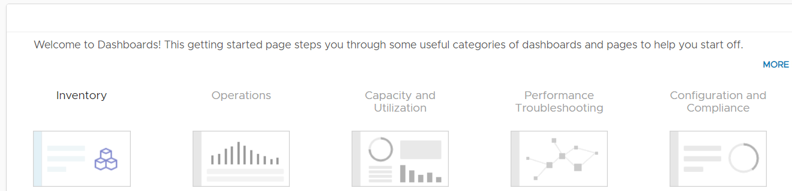
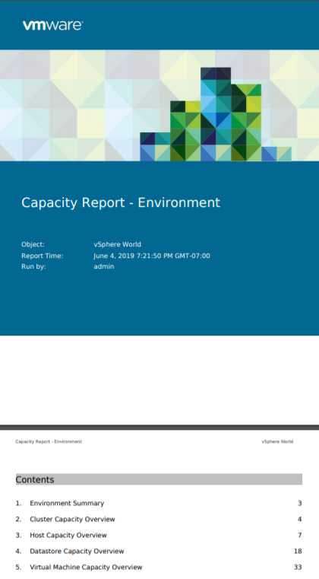
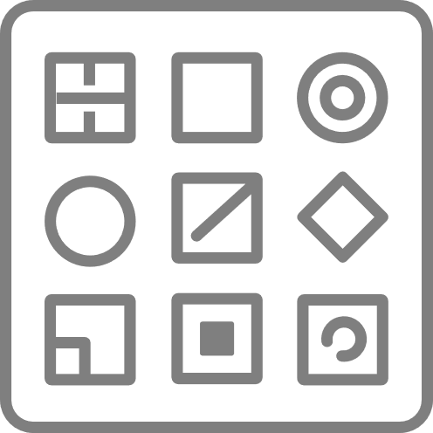
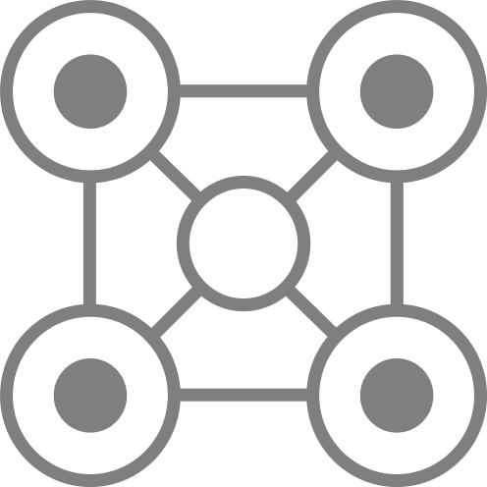
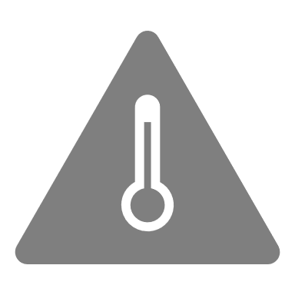
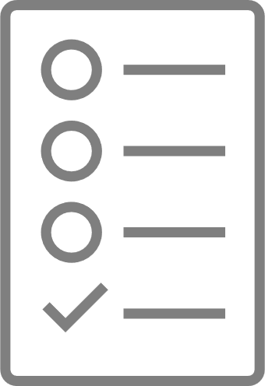
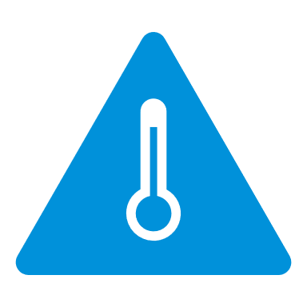
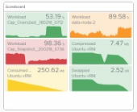
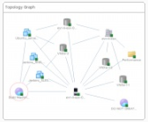
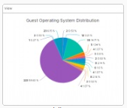
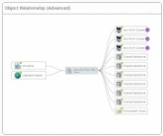
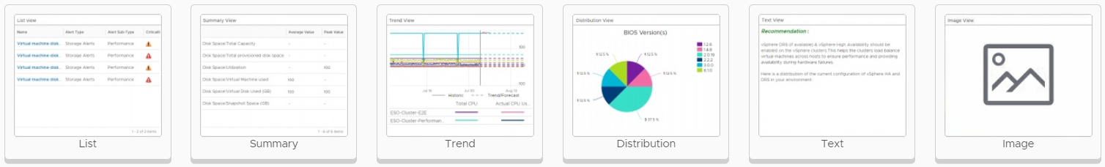

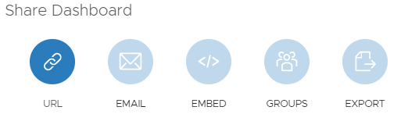










Enhanced visibility with predictive alerts, dashboard and reports
Increase monitoring efficiency with key operational tools
ALERTS
DASHBOARDS
REPORTS
Alert Definitions
Dashboards
Report Templates
50+ Out of box report templates covering multiple use cases
Inventory
Configuration
Compliance
Capacity
Utilization
Performance
Impacted Objects
Impact Type
Correlated Symptoms
Recommendations & Actions
Helps visualize data through out of box and custom dashboards
Optimization
Other Solutions
Custom
Symptoms
Widgets & Views
PDF | CSV
Data Transformation
Events
Configs
Metrics
Rest
40+ Interactive Widgets & 100+ customized views with data transformation capabilities
Multiple views for excel like capabilities to transform data and present them within report templates
Recommendations
Dashboard Sharing
Report Sharing
KB Articles
Actions
Custom
Dashboard sharing with internal & external teams
Manual
Report Generation
Scheduled
Curated Python Actions
Curated/Custom vRO Workflows
Rest API
API
Actions
Community curated dashboard samples through GitHub
Email
Report Sharing
Network Share
API
Rest API
Notes:
Recommendations>Actions
Dashboard sharing and code.vmware.com
Reports > management!

Slide 23








Connecting to Aria Operations
Skyline
Multi-Cloud
APMs
Network Insight
Operations
Automatiom
Logs
True VIsibility
CloudHealth
3rd Party
MP Designer
Management packs

Slide 24
Aria Operations / Aria Operations Cloud
Key Benefits
Accelerate service & innovation delivery
Reduce time to market and automate infrastructure delivery
Improve agility
No hardware and no maintenance
Increase Flexibility
Reduced risk and CAPEX to OPEX
Scale rapidly
Dynamic and reliable with VMware SRE support
Future Ready
Manage traditional and cloud-native workloads across private, hybrid and multi-cloud environments

Slide 25
Cloud Management New Family Brand: Aria
Old Name | New Name
Automation
vRealize Automation / Cloud | VMware Aria Automation
VMware Cloud Assembly | VMware Aria Automation Assembler
VMware Service Broker | VMware Aria Automation Consumption
VMware Code Stream | VMware Aria Automation Pipelines
VMware Cloud Templates | VMware Aria Automation Templates
vRealize Orchestrator | VMware Aria Automation Orchestrator
vRealize Automation SaltStack Config | VMware Aria Automation Config
vRealize Automation SaltStack SecOps | VMware Aria Automation for Secure Hosts
CloudHealth Secure State | VMware Aria Automation for Secure Clouds
Operations
vRealize Operations / Cloud | VMware Aria Operations
vRealize Log Insight / Cloud | VMware Aria Operations for Logs
vRealize Network Insight / Cloud | VMware Aria Operations for Networks
Tanzu Observability by Wavefront | VMware Aria Operations for Applications
vRealize True Visibility Suite | VMware Aria Operations for Integrations
Cost
CloudHealth | VMware Aria Cost powered by CloudHealth
Old Name | New Name
Suites
vRealize Cloud Universal | VMware Aria Universal Suite
vRealize Suite | VMware Aria Suite
vCloud Suite | VMware vCloud Suite
CloudHealth by VMware Suite | Discontinued Name
CloudHealth Partner Platform | Discontinued - see Aria Cost powered by CH
Platform & Cross-Cloud Services
Project Ensemble | VMware Aria Hub
New | VMware Aria Graph
vRealize Migration Manager | VMware Aria Migration
vRealize Automation Cloud Guardrails | VMware Aria Guardrails
Project Ensemble Insights | VMware Aria Business Insights
Other
Skyline | VMware Skyline
vRealize Suite Lifecycle Manager | VMware Aria Suite Lifecycle
vRealize Cloud Subscription Manager | VMware Aria Hub Subscription
vRealize AI Cloud | Functionality part of Aria Hub; name discontinued
Notes:
Before we go on, let’s kill the elephant in the room
WHAT ABOUT THAT NAME CHANGE RECENTLY?
Always use full product names in any externally-facing content.
At the first mention add can drop it in subsequent mentions
Never abbreviate the names. Exception: in product UI (menus and drop-downs) if the full name doesn’t fit you may drop “VMware Aria” (together only)

Slide 26






VMware Cloud Management Recognized by the Industry
#1 IDC Market Share
A LEADER in The Forrester Wave™
#1 OMDIA Universe
IDC IT Automation and Configuration Management Market Share
IDC WW Cloud Systems and Service Management Market Share
Forrester Hybrid Cloud Management Wave™
Forrester Infrastructure Automation Wave™
Forrester Cloud Cost Management and Optimization Wave™
OMDIA Selecting a Hybrid & Multicloud Management Solution
Source: IDC, Worldwide Cloud System and Service Management Software Market Shares, 2019: SaaS and ITOM Drive Growth, Doc #US45083420, May 2020Cloud Mgt Market Share
The Forrester WaveTM is copyrighted by Forrester Research, Inc. Forrester and Forrester WaveTM are trademarks of Forrester Research, Inc. The Forrester WaveTM is a graphical representation of Forrester’s call on a market and is plotted using a detailed spreadsheet with exposed scores, weightings, and comments. Forrester does not endorse any vendor, product, or service depicted in the Forrester WaveTM. Information is based on best available resources. Opinions reflect judgment at the time and are subject to change.
Forrester, Inc., The Forrester Wave™: Hybrid Cloud Management, Q4 2020, November 30, 2020
Forrester, Inc., The Forrester Wave™: Infrastructure Automation Platforms, Q3 2020, August 10, 2020
Forrester, Inc., The Forrester Wave™: Cloud Cost Management and Optimization, Q4 2020, October 28, 2020
Source: OMDIA Universe, Selecting a Hybrid and Multicloud Management Solution, 2020-2021Mgt Market Share
Source: IDC, Worldwide IT Automation and Configuration Management Software Market Shares, 2019: Market Expands Ahead of Coronavirus Impact, Doc# US46397520, June 2020
Notes:
VMware Aria cloud management is not only trusted by customers worldwide, but also recognized by industry analysts as #1 in market share by IDC, as a leader in the market by Forrester in these 3 Forrester Wave reports, and by OMDIA in the OMDIA Universe report.
Plus, VMware Aria was recognized by Gartner Peer Insights: Customers’ Choice Award: IT Infrastructure Monitoring Tools.
Transition: Let’s summarize this for you.

